Slide 1
UNIT-3. ELECTRICAL SAFETY, WIRING, EARTHING, MEASURING INSTRUMENTS & ELECTRONICS

Slide 2
ELECTRICAL WIRING

Slide 3

HOUSE WIRING

Slide 4
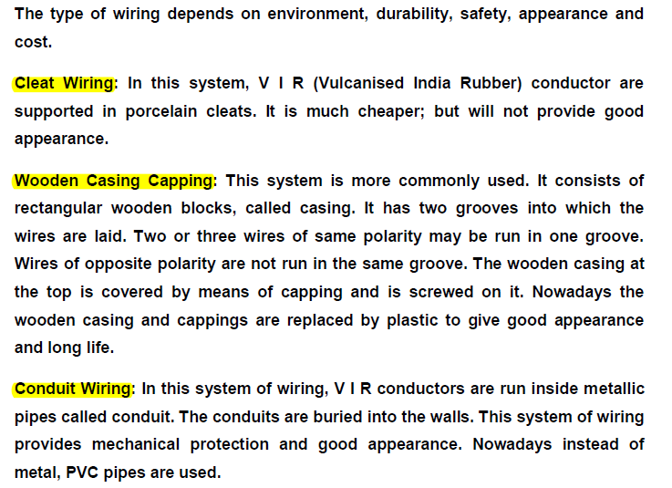
TYPES OF WIRING

Slide 5
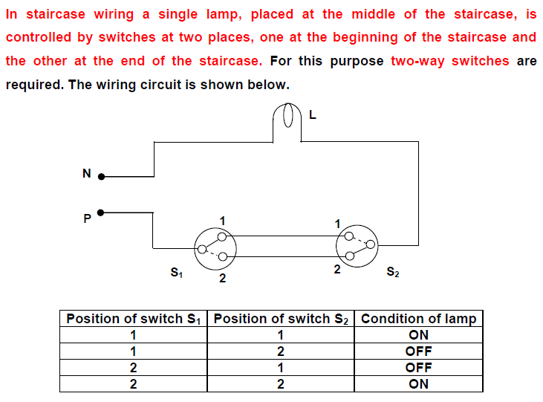
STAIRCASE WIRING

Slide 6
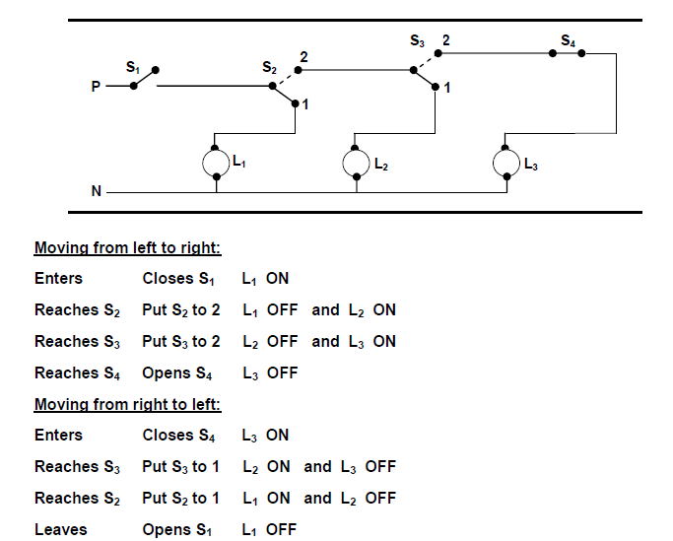
CORRIDOR WIRING

Slide 7
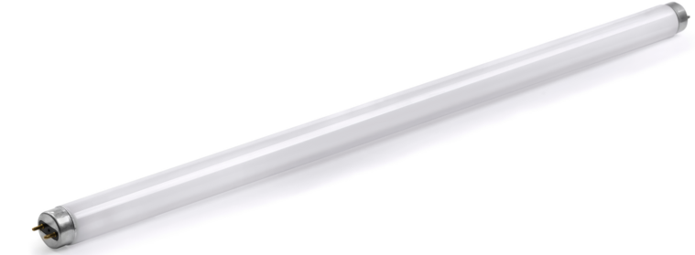
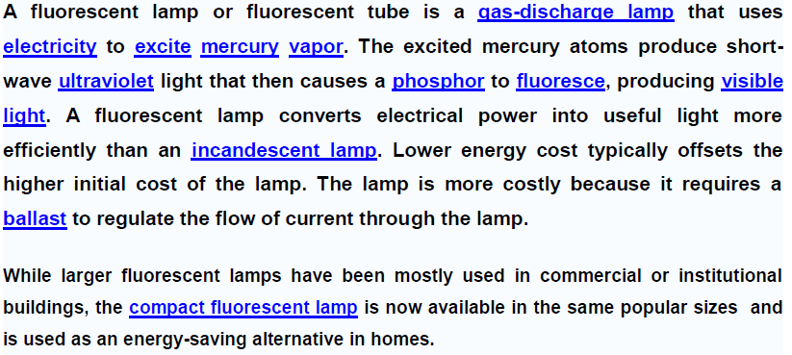
FLUORESCENT LAMP

Slide 8
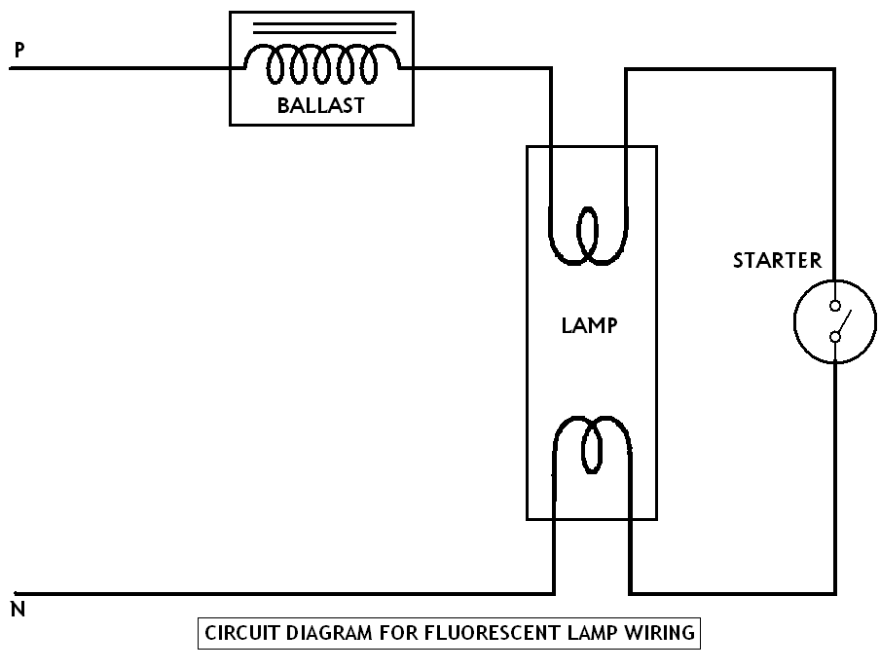

Slide 9
Safety Precautions when Working with Electricity
1. Never touch or try repairing any electrical equipment or circuits with wet hands. It increases the conductivity of electric current.
2. Never use equipment with damaged insulation or broken plugs.
3. If you are working on any electrical socket at your home then always turn off the mains.
4. Always use insulated tools while working.(never use aluminium or steel ladder )
5. Electrical hazards include exposed energized parts and unguarded electrical equipment which may become energized unexpectedly -carries warning signs like “Shock Risk”. Always be observant such electrical signs.

Slide 10
6. when working electrical circuit always use appropriate insulated rubber gloves and goggles.
7. Never try repairing energized equipment. Always check that it is de-energized first by using a tester. When an electric tester touches a live or hot wire, the bulb inside the tester lights up showing that an electrical current is flowing through the respective wire.
8. Know the wire code of your country.
9. Always use a circuit breaker or fuse with the appropriate current rating. Circuit breakers and fuses are protection devices that automatically disconnect the live wire when a condition of short circuit or over current occurs. The selection of the appropriate fuse or circuit breaker is essential.

Slide 11
EARTHING

Slide 12
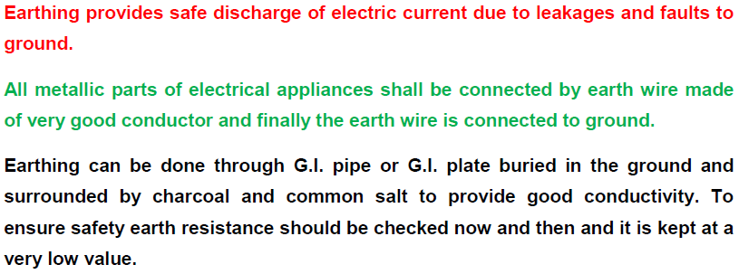
EARTHING

Slide 13
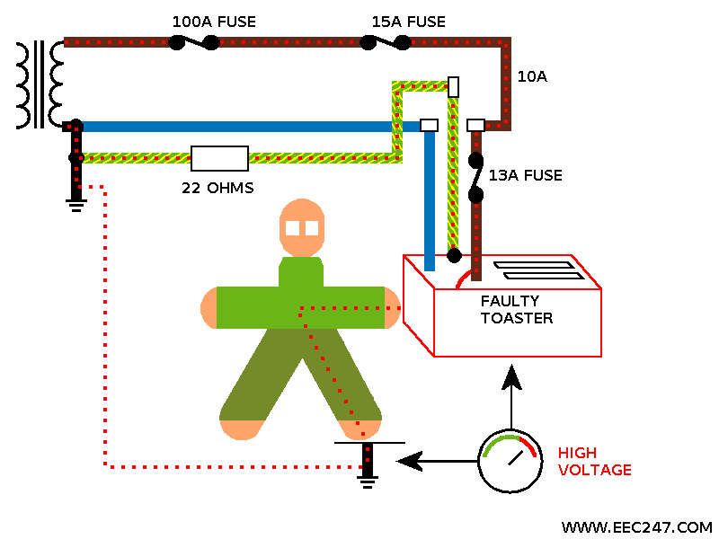
What Is Earthing
The process of connecting metallic bodies of all the electrical apparatus and equipment to huge mass of earth by a wire having negligible resistance is called Earthing.

Slide 14
Objectives of the earthing
Provide an alternative path for the fault current to flow so that it will not endanger the user
Ensure that all exposed conductive parts do not reach a dangerous potential
Maintain the voltage at any part of an electrical system at a known value so as to prevent over current or excessive voltage on the appliances or equipment.

Slide 15
Qualities Of Good Earthing
Must be of low electrical resistance
Must be of good corrosion resistance
Must be able to dissipate high fault current repeatedly

Slide 16
Purpose of Earthing
To save human life from danger of electrical shock or death by blowing a fuse i.e. To provide an alternative path for the fault current to flow so that it will not endanger the user
To protect buildings, machinery & appliances under fault conditions ie. To ensure that all exposed conductive parts do not reach a dangerous potential.
To provide safe path to dissipate lightning and short circuit currents.
To provide stable platform for operation of sensitive electronic equipments i.e. To maintain the voltage at any part of an electrical system at a known value so as to prevent over current or excessive voltage on the appliances or equipment .
To provide protection against static electricity from friction

Slide 17
Electric shock
An electric shock (electrocution)occurs when two portion of a person’s body come in contact with electrical conductors of a circuit which is at different potentials, thus producing a potential difference across the body.
The human body does have resistance and when the body is connected between two conductors at different potential a circuit is formed through the body and current will flow
When the human body comes in contact with only one conductor, a circuit is not formed and nothing happens. When the human body comes in contact with circuit conductors, no matter what the voltage is there is potential for harm.

Slide 18
Electric shock
The higher the potential difference the more the damage. The effect of an electric shock is a function of what parts of body come in contact with each conductor, the resistance of each contact point the surface resistance of the body at the contact as well as other factor.
When the electrical contact is such that the circuit path through the body is across the heart, you have the greatest potential for death.

Slide 19
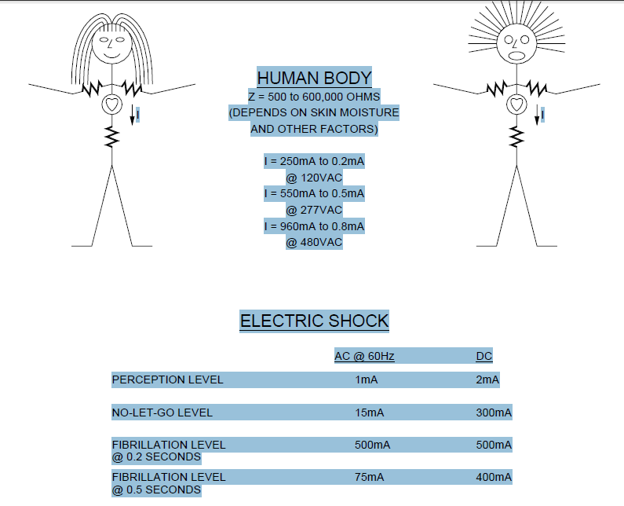
Electric shock
When a high voltage such as 13,800V is involved the body is literally cooked and at times explodes

Slide 20
Types of Earthing
Plate Earthing
Pipe Earthing

Slide 21
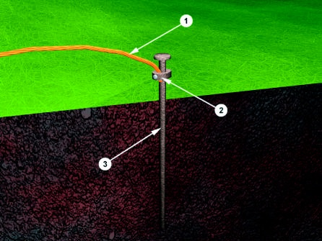
Earthing Electrode
The resistance of a ground
electrode has 3 basic
components:
A) The resistance of the ground
electrode itself and the connections
to the electrode.
B) The contact resistance of the
surrounding earth to the electrode.
C) The resistance of the surrounding
body of earth around the ground
Electrode. It consist of three basic components:
Earth Wire
Connector
Electrode

Slide 22
Plate Earthing
In this type of earthing plate either of copper or of G.I. is buried into the ground at a depth of not less than 3 meter from the ground level.
The earth plate is embedded in alternative layer of coke and salts for a minimum thickness of about 15cm.
The earth wire(copper wire for copper plate earthing and G.I. wire for G.I. plate earthing) is securely bolted to an earth plate with the help of bolt nut and washer made of copper, in case of copper plate earthing and of G.I. in case of G.I. plate earthing.

Slide 23
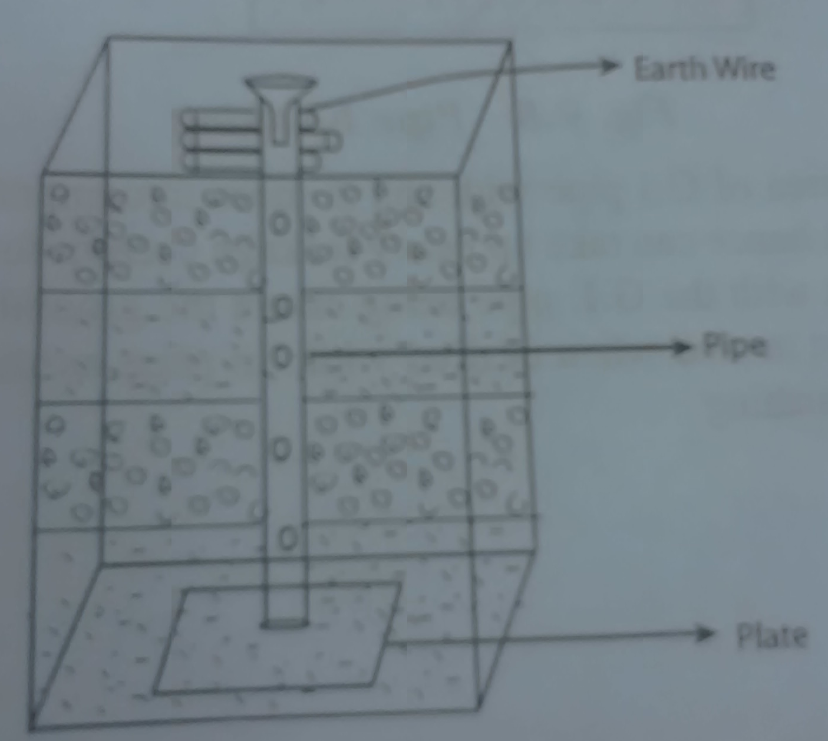
PLATE EARTHING

Slide 24
Pipe earthing
Pipe earthing is best form of earthing and it is cheap also in this system of earthing a GI pipe of 38 mm dia and 2meters length is embedded vertically in ground to work as earth electrode but the depth depend upon the soil conditions, there is no hard and fast rule for this.
But the wire is embedded up to the wet soil.
The earth wire are fastened to the top section of the pipe with nut and bolts.
The pit area around the GI pipe filled with salt and coal mixture for improving the soil conditions and efficiency of the earthing system.
It can take heavy leakage current for the same electrode size in comparison to plate earthing.
The earth wire connection with GI pipes being above the ground level can be checked for carrying out continuity test as and when desired, while in plate earthing it is difficult.
In summer season to have an effective earthing three or four bucket of water is put through the funnel for better continuity of earthing.

Slide 25
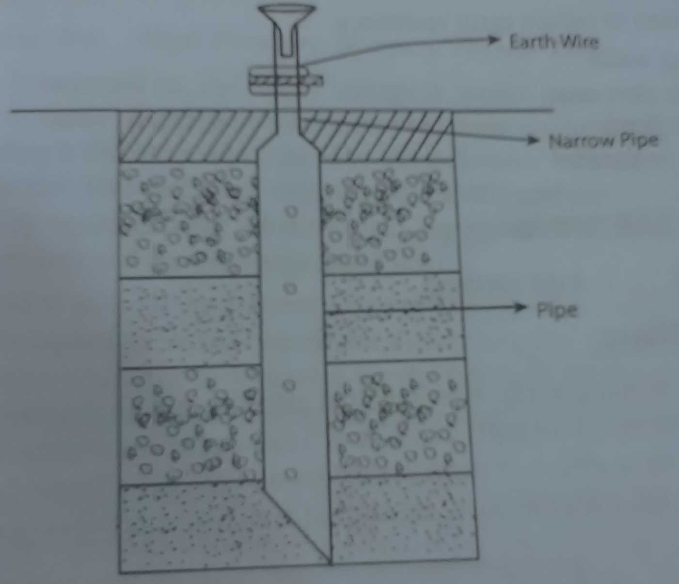
PIPE EARTHING

Slide 26
Unit-3 MEASURING INSTRUMENTS
PMMC
PMMI
Dynamometer
Induction
Thermal
Rectifier
Measurement of voltage and current

Slide 27
Permanent Magnet Moving Coil (PMMC) Instrument
The PMMC type instrument uses two permanent magnets in order to create stationary magnetic field.
These types of instruments are only used for measuring the dc quantities.
If we apply ac current to these type of instruments the direction of electric current will be reversed during negative half cycle and hence the direction of torque will also be reversed which gives average value of torque zero.
The pointer will not deflect due to high frequency from its mean position showing zero reading. However it can measure the direct current very accurately.

Slide 28
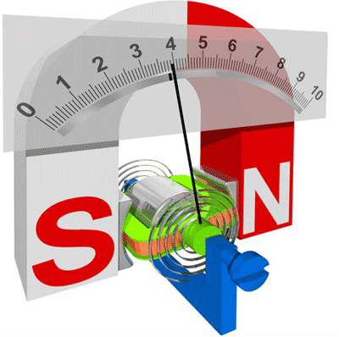

Slide 29
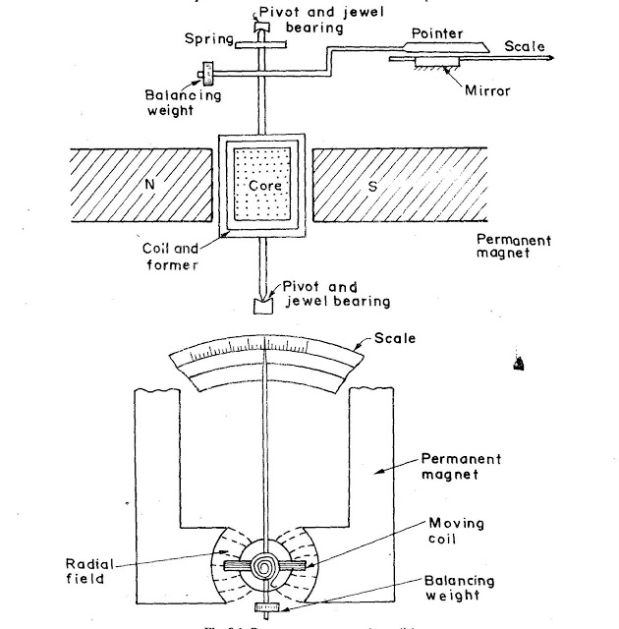

Slide 30
(a) Stationary part or magnet system: In the present time we use magnets of high field intensities, high coercive force instead of using U shaped permanent magnet having soft iron pole pieces. The magnets which we are using nowadays are made up of materials like alcomax and alnico which provide high field strength.
(b) Moving coil: The moving coil can freely moves between the two permanent magnets as shown in the figure given below. The coil is wound with many turns of copper wire and is placed on rectangular aluminium which is pivoted on jeweled bearings.
(c) Control system: The spring generally acts as control system for PMMC instruments. The spring also serves another important function by providing the path to lead current in and out of the coil.

Slide 31
(d) Damping system: The damping force hence torque is provided by movement of aluminium former in the magnetic field created by the permanent magnets.
(e) Meter: Meter of these instruments consists of light weight pointer to have free movement and scale which is linear or uniform and varies with angle.

Slide 32
In PMMC meter or (D’Arsonval) meter or galvanometer all are the same instrument, a coil of fine wire is suspended in a magnetic field produced by permanent magnet.
According to the fundamental law of electromagnetic force, the coil will rotate in the magnetic field when it carries an electric current by electromagnetic (EM) torque effect.
A pointer which attached the movable coil will deflect according to the amount of current to be measured which applied to the coil.
The (EM) torque is counterbalance by the mechanical torque of control springs attached to the movable coil also.
When the torques are balanced the moving coil will stopped and its angular deflection represent the amount of electrical current to be measured against a fixed reference, called a scale.
If the permanent magnet field is uniform and the spring linear, then the pointer deflection is also linear.

Slide 33
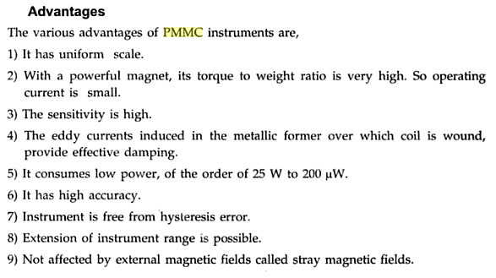

Slide 34
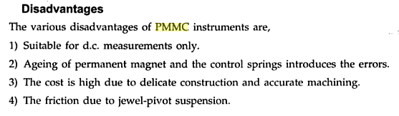

Slide 35
Permanent Magnet Moving Iron (PMMI) Instrument
M.I instruments are mainly used for the measurement of alternating currents and voltages, though it can also be used for D.C measurements.
Moving iron type instruments are of mainly two types. Attraction type and repulsion type instrument.

Slide 36
Attraction type Moving Iron Instrument
Whenever a plate or vane of soft iron or of high permeability steel forms the moving element is placed nearer to a magnet it would be attracted by the magnet.
The force of this attraction depends upon the strength said magnetic field.
If the magnet is electromagnet then the magnetic field strength can easily be increased or decreased by increasing or decreasing electric current through its coil.
Accordingly the attraction force acting on the piece of iron would also be increased and decreased.
Depending upon this simple phenomenon attraction type moving iron instrument was developed.

Slide 37
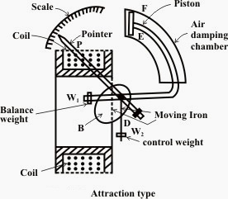
In this type of instrument, a single soft iron vane (moving iron) is mounted on the spindle, and is attracted towards the coil when operating current flows through it.

Slide 38
This iron tends to move inward that is from weaker magnetic field to stronger magnetic field when current flowing through the coil.
In attraction moving instrument gravity control was used previously but now gravity control method is replaced by spring control in relatively modern instrument.
By adjusting balance weight null deflection of the pointer is achieved.
The required damping force is provided in this instrument by air friction.
The figure shows a typical type of damping system provided in the instrument, where damping is achieved by a moving piston in an air syringe.

Slide 39
Repulsion type Moving Iron Instrument
In this two soft iron vanes are used
one fixed and attached the stationary coil,
other is movable (moving iron), and mounted on the spindle of the instrument.
When operating current flows through the coil, the two vanes are magnetized, developing similar polarity at the same ends.
Consequently, repulsion takes place between the vanes and the movable vane causes the pointer to move over the scale.

Slide 40
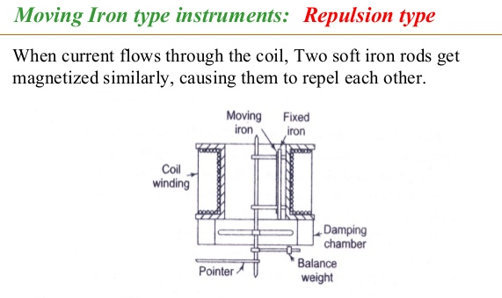

Slide 41
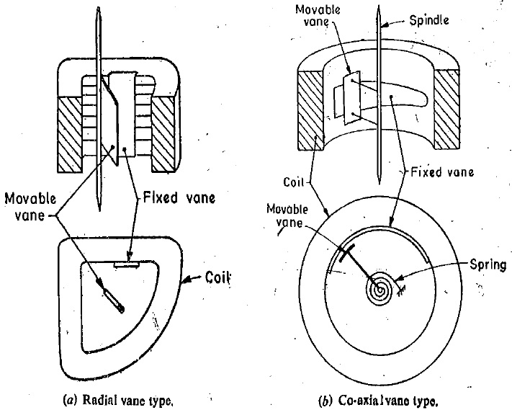
a. Radial Vane Type: - vanes are radial strips of iron.
b. Co-axial Vane Type:- vanes are sections of coaxial cylinders.

Slide 42
This repulsion force is due to same magnetic poles induced in same sides the iron pieces due external magnetic field.
This repulsion force increases if field strength of the magnet is increased. Like case if the magnet is electromagnet, then magnetic field strength can easily be controlled by controlling input current to the magnet.
Hence if the electric current increases the repulsion force between the pieces of iron is increased and it the current decreases the repulsion force between them is decreased.
Depending upon this phenomenon repulsion type moving iron instrument was constructed

Slide 43
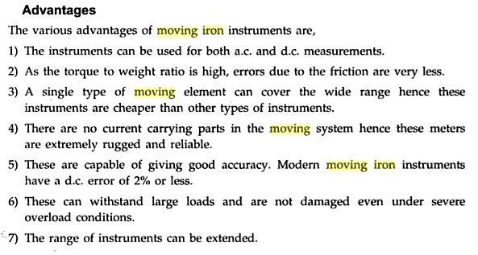

Slide 44
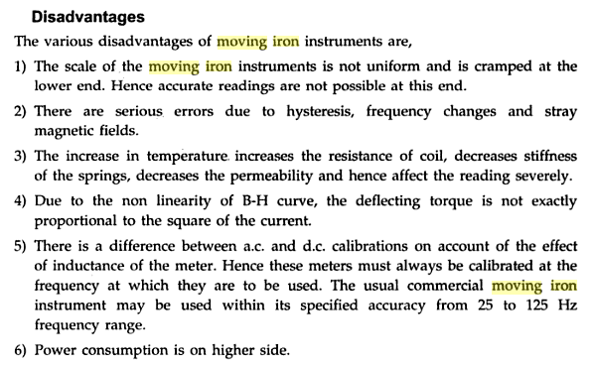

Slide 45
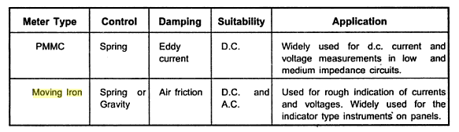

Slide 46
Electronic devices
PN- DIODE

Slide 47
SEMICONDUCTOR DIODE
Theory of p-n junction
p-n junction as diode
p-n diode currents
Volt-amp characteristics
Diode resistance
Temperature effect of p-n junction
Transition and diffusion capacitance of p-n diode
Diode switching times

Slide 48
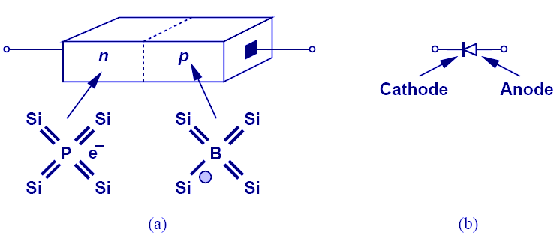
PN Junction (Diode)
When N-type and P-type dopants are introduced side-by-side in a semiconductor, a PN junction or a diode is formed.
The p-n junction is also called as semiconductor diode .
The left side material is a p-type semiconductor having –ve acceptor ions and +vely charged holes. The right side material is n-type semiconductor having +ve donor ions and free electrons

Slide 49
p-n junction as diode
Suppose the two pieces are suitably treated to form pn junction, then there is a tendency for the free electrons from n-type to diffuse over to the p-side and holes from p-type to the n-side . This process is called diffusion
The left side material is a p-type semiconductor having –ve acceptor ions and +vely charged holes. The right side material is n-type semiconductor having +ve donor ions and free electrons.

Slide 50
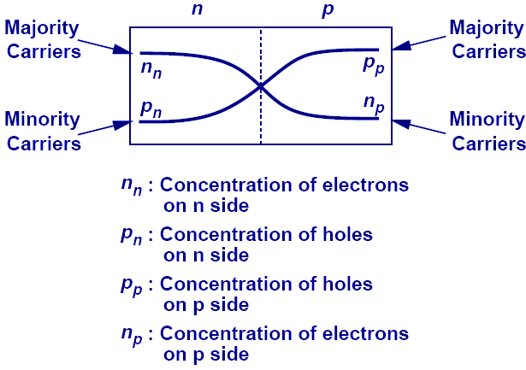
Current Flow Across Junction: Diffusion
Because each side of the junction contains an excess of holes or electrons compared to the other side, there exists a large concentration gradient. Therefore, a diffusion current flows across the junction from each side.

Slide 51
p-n junction as diode
As the free electrons move across the junction from n-type to p-type, +ve donor ions are uncovered. Hence a +ve charge is built on the n-side of the junction. At the same time, the free electrons cross the junction and uncover the –ve acceptor ions by filling in the holes. Therefore a net –ve charge is established on p-side of the junction.

Slide 52
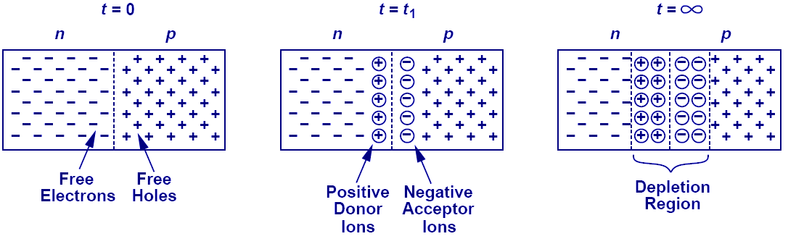
Depletion Region
As free electrons and holes diffuse across the junction, a region of fixed ions is left behind. This region is known as the “depletion region.”

Slide 53
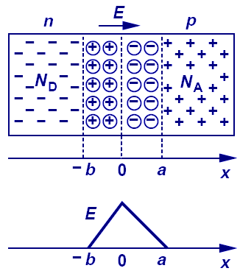
Current Flow Across Junction: Drift
The fixed ions in depletion region create an electric field that results in a drift current.

Slide 54
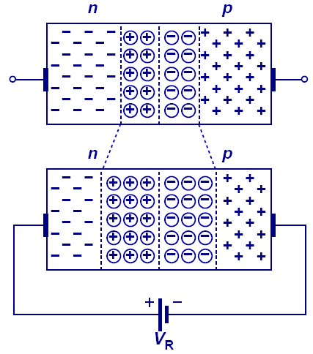
Diode in Reverse Bias
When the N-type region of a diode is connected to a higher potential than the P-type region, the diode is under reverse bias, which results in wider depletion region and larger built-in electric field across the junction.

Slide 55
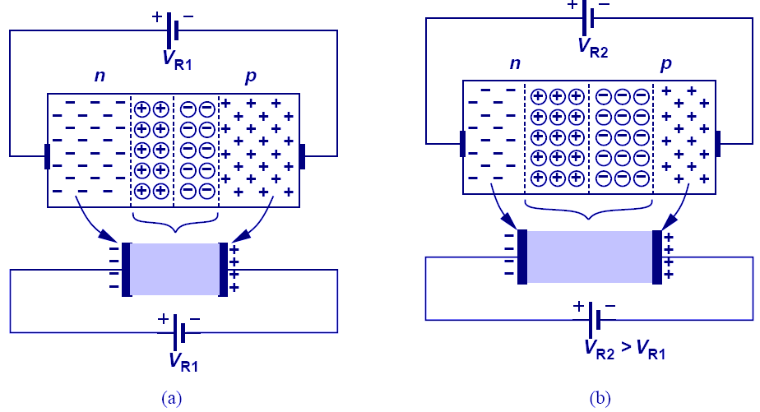
Reverse Biased Diode’s Application: Voltage-Dependent Capacitor
The PN junction can be viewed as a capacitor. By varying V_{R}, the depletion width changes, changing its capacitance value; therefore, the PN junction is actually a voltage-dependent capacitor.

Slide 56
p-n junction as diode
When a sufficient number of donor and acceptor ions is uncovered further diffusion is prevented.
Thus a barrier is set up against further movement of charge carriers. This is called potential barrier or junction barrier Vo. The potential barrier is of the order of 0.1 to 0.3V.
Note: outside this barrier on each side of the junction, the material is still neutral. Only inside the barrier, there is a +ve charge on n-side and –ve charge on p-side. This region is called depletion layer.

Slide 57
Volt-amp characteristics
A
R
V
diode
V
IF(mA)
Break over
Voltage
VR
VF
Knee voltage
IR(μA
)

Slide 58
Volt-amp characteristics
The supply voltage V is a regulated power supply, the diode is forward biased in the circuit shown. The resistor R is a current limiting resistor. The voltage across the diode is measured with the help of voltmeter and the current is recorded using an ammeter.
By varying the supply voltage different sets of voltage and currents are obtained. By plotting these values on a graph, the forward characteristics can be obtained. It can be noted from the graph the current remains zero till the diode voltage attains the barrier potential.
For silicon diode, the barrier potential is 0.7 V and for Germanium diode, it is 0.3 V. The barrier potential is also called as knee voltage or cut-in voltage.

Slide 59
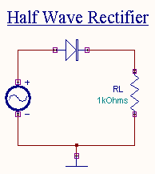
HALFWAVE RECTIFIER

Slide 60
HALFWAVE RECTIFIER
The primary of the transformer is connected to ac supply. This induces an ac voltage across the secondary of the transformer.
During the positive half cycle of the input voltage the polarity of the voltage across the secondary forward biases the diode. As a result a current IL flows through the load resistor, RL. The forward biased diode offers a very low resistance and hence the voltage

Slide 61
HALFWAVE RECTIFIER
Drop across it is very small. Thus the voltage appearing across the load is practically the same as the input voltage at every instant.
During the negative half cycle of the input voltage the polarity of the secondary voltage gets reversed. As a result, the diode is reverse biased.
Practically no current flows through the circuit and almost no voltage is developed across the resistor. All input voltage appears across the diode itself.

Slide 62
HALFWAVE RECTIFIER
Hence we conclude that when the input voltage is going through its positive half cycle, output voltage is almost the same as the input voltage and during the negative half cycle no voltage is available across the load.
This explains the unidirectional pulsating dc waveform obtained as output. The process of removing one half the input signal to establish a dc level is aptly called half wave rectification.

Slide 63
HALFWAVE RECTIFIER
Peak Inverse Voltage
When the input voltage reaches its maximum value Vm during the negative half cycle the voltage across the diode is also maximum. This maximum voltage is known as the peak inverse voltage.
Thus for a half wave rectifier
Let Vi be the voltage to the primary of the transformer. Vi is given by
where Vr is the cut-in voltage of the diode.

Slide 64
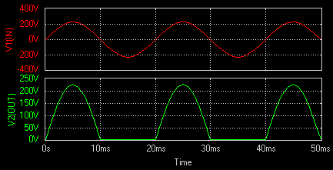
Half wave waveform

Slide 65
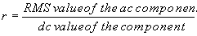
HALFWAVE RECTIFIER
Ripple Factor
Ripple factor is defined as the ratio of rms value of ac component to the dc component in the output.
Ripple factor

Slide 66
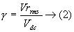
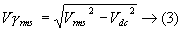
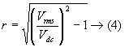
HALFWAVE RECTIFIER
The ripple is

Slide 67
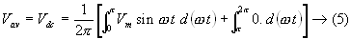
HALFWAVE RECTIFIER
Vav the average or the dc content of the voltage across the load is given by

Slide 68
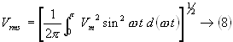
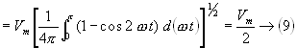
HALFWAVE RECTIFIER
RMS voltage at the load resistance can be calculated as

Slide 69
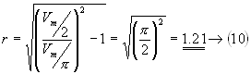
HALFWAVE RECTIFIER
Ripple Factor

Slide 70
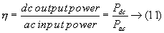
HALFWAVE RECTIFIER
Efficiency Efficiency, is the ratio of the dc output power to ac input power

Slide 71
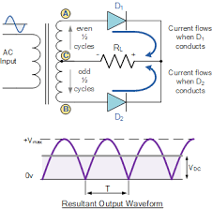
Full Wave Rectifier
The waveform of fullwave rectifier is
Ripple factor=0.48; efficiency=81.2%; PIV=2Vm

Slide 72
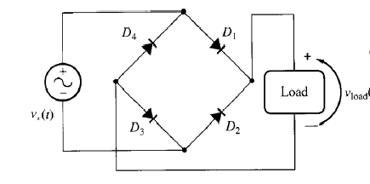
Full Wave Bridge Rectifier

Slide 73
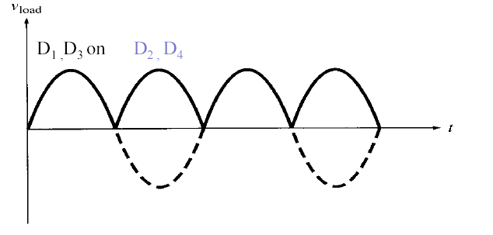
The waveform of fullwave bridge rectifier is
Ripple factor=0.48; efficiency=81.2%; PIV=Vm
The waveform of fullwave rectifier is
Ripple factor=0.48; efficiency=81.2%; PIV=2Vm

Slide 74
Zener Diode
Zener Diode : Works in the break down region when subjected to reverse bias.
Large variation in current. Voltage almost constant.
Used for voltage regulation. Upper limit of current depends on the power dissipation rating of the device.

Slide 75
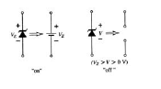
Zener Diode
Zener diode

Slide 76
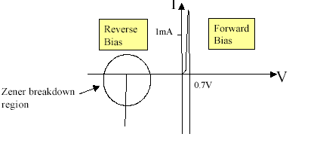
V-I Characteristics of Zener Diode

Slide 77
V-I Characteristics of Zener Diode
Zener diodes are manufactured to have a very low reverse bias breakdown voltage
Since the breakdown at the zener voltage is so sharp, these devices are often used in voltage regulators to provide precise voltage references. The actual zener voltage is device dependent. For example, you can buy a 6V zener diode.

Slide 78
Clipper circuits
Clipping circuits
“A clipper is a device which limits, remove or prevents some portion of the wave form (input signal voltage) above or below a certain level.”
In other words
“the circuit which limits positive or negative amplitude ,or both is called clipping circuit.”

Slide 79
Types of clippers
The clipper circuits are of the following types.
Series positive clipper
Series negative clipper
Shunt or parallel clipper
Shunt or parallel positive negative
Clipper Dual (combination)Diode clipper

Slide 80
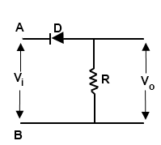
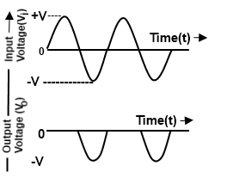
Series positive clipper
Positive clipper
Output voltage

Slide 81
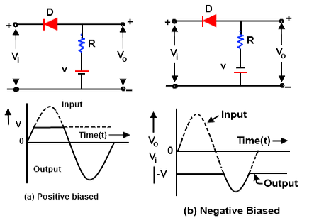
SERIES-POSITIVE CLIPPER WITH BIAS

Slide 82
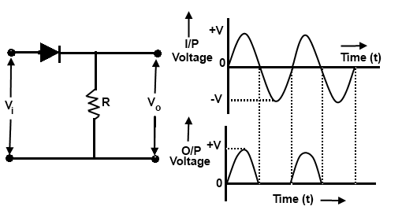
SERIES NEGATIVE CLIPPER

Slide 83
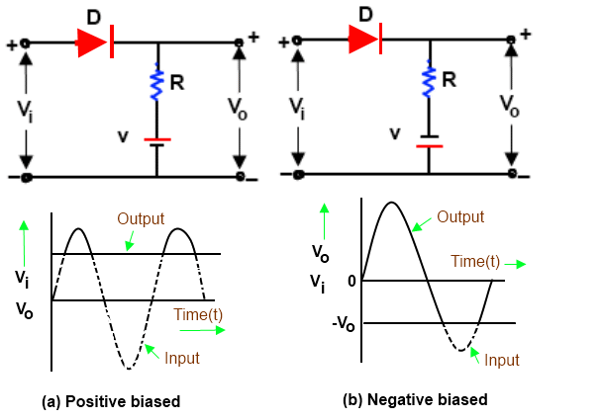
SERIES-NEGATIVE CLIPPER WITH BIAS

Slide 84
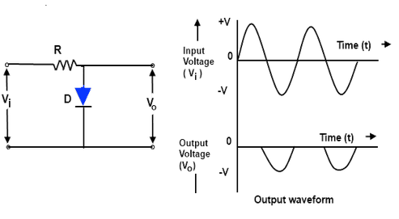
SHUNT OR PARALLEL POSITIVE CLIPPER

Slide 85

SHUNT OR PARALLEL POSITIVE CLIPPER WITH BIAS

Slide 86

SHUNT OR PARALLEL NEGATIVE CLIPPER

Slide 87

SHUNT OR PARALLEL NEGATIVE CLIPPER WITH BIAS

Slide 88

DUAL (COMBINATION) DIODE CLIPPER

Slide 89
Clipper applications
Clippers can be used as voltage limiters and amplitude selectors.
half wave rectifier
protection of transistor from transients
excessive noise spikes above a certain level can be limited or clipped in FM transmitters

Slide 90
Clamper circuits
A circuit that places either the positive or negative peak of a signal at a desired D.C level is known as a clamping circuit.
A clamping circuit introduces (or restores) a D.C level to an A.C signal.
Thus a clamping circuit is also known as D.C restorer.
the original signal will not get changed, only there is vertical shift in the signal.

Slide 91
Types of clampers
Positive clamper - Positive clamping
occurs when negative peaks raised or clamped to ground or on the zero level
In other words, it pushes the signal upwards so that negative peaks fall on the zero level.
Negative clamper - Negative clamping
occurs when positive peaks raised or clamped to ground or on the zero level
In other words, it pushes the signal downwards so that the positive peaks fall on the zero level.

Slide 92

Positive clamper

Slide 93

Positive clamper with positive bias

Slide 94

Positive clamper with negative bias

Slide 95

Negative clamper

Slide 96

Negative clamper with positive bias

Slide 97

Negative clamper with negative bias

Slide 98
applications
Applications of clamping circuits
They find some applications in sonar and radar testing
Used as voltage doublers
They are used to remove distortions in a circuit
Used in video processing equipment like TV
base line stabilizer

Slide 99


Transistor Structures
The bipolar junction transistor (BJT) has three separately doped regions and contains two pn junctions.
Bipolar transistor is a 3-terminal device.
Emitter (E)
Base (B)
Collector (C)
The basic transistor principle is that the voltage between two terminals controls the current through the third terminal.
Current in the transistor is due to the flow of both electrons and holes, hence the name bipolar.

Slide 100




Transistor Structures
There are two types of bipolar junction transistor: npn and pnp.
The npn bipolar transistor contains a thin p-region between two n-regions.
The pnp bipolar transistor contains a thin n-region sandwiched between two p-regions.

Slide 101
The BJT – Bipolar Junction Transistor
✶ Note: It will be very helpful to go through the Analog Electronics Diodes Tutorial to get information on doping, n-type and p-type materials.
The Two Types of BJT Transistors:
npn
pnp
n
p
n
p
n
p
E
C
E
C
Cross Section
C
Cross Section
C
B
B
B
B
Schematic Symbol
Schematic Symbol
E
E
Collector doping is usually ~ 10⁶
Base doping is slightly higher ~ 10⁷ – 10⁸
Emitter doping is much higher ~ 10¹⁵

Slide 102


FORMATION OF p–n–p AND n–p–n JUNCTIONS
When an n-type thin semiconductor layer is placed between two p-type semiconductors, the resulting structure is known as the p–n–p transistor.
The fabrication steps are complicated, and demand stringent conditions and measurements.
When a p-type semiconductor is placed between two n-type semiconductors, the device is known as the n–p–n transistor.
p–n–p transistor
n–p–n transistor

Slide 103

TRANSISTOR MECHANISM
The basic operation of the transistor is described using the p–n–p transistor.
The p–n junction of the transistor is forward-biased whereas the base-to-collector is without a bias.
The depletion region gets reduced in width due to the applied bias, resulting in a heavy flow of majority carriers from the p-type to the n-type material gushing down the depletion region and reaching the base.
The forward-bias on the emitter–base junction will cause current to flow.
Forward-biased junction of a p–n–p transistor

Slide 104

TRANSISTOR MECHANISM
For easy analysis, let us now remove the base-to-emitter bias of the p–n–p transistor.
The flow of majority carriers is zero, resulting in a minority-carrier flow. Thus, one p–n junction of a transistor is reverse-biased, while the other is kept open.
The operation of this device becomes much easier when they are considered as separate blocks. In this discussion, the drift currents due to thermally generated minority carriers have been neglected, since they are very small.
Reverse-biased junction of a p–n–p transistor

Slide 105
BJT Relationships - Equations
I_{E}
I_{C}
I_{E}
I_{C}
-
V_{CE}
+
+
V_{EC}
-
E
C
E
C
-
-
+
+
V_{BE}
I_{B}
V_{BC}
V_{EB}
V_{CB}
I_{B}
+
+
-
-
B
B
npn
I_{E} = I_{B} + I_{C}
V_{CE} = -V_{BC} + V_{BE}
pnp
I_{E} = I_{B} + I_{C}
V_{EC} = V_{EB} - V_{CB}
Note: The equations seen above are for the transistor, not the circuit.

Slide 106

TRANSISTOR CURRENT COMPONENTS
Current Components in p–n–p Transistor
Both biasing potentials have been applied to a p–n–p transistor, with the resulting majority and minority carrier flow indicated.
The width of the depletion region clearly indicates which junction is forward-biased and which is reverse-biased.
The magnitude of the base current is typically in the order of microamperes as compared to mill amperes for the emitter and collector currents. The large number of these majority carriers will diffuse across the reverse-biased junction into the p-type material connected to the collector terminal
Direction of flow of current in p–n–p transistor with the base–emitter junction forward-biased and the collector–base junction reverse-biased

Slide 107

TRANSISTOR CURRENT COMPONENTS
Current Components in an n–p–n Transistor
The operation of an n–p–n transistor is the same as that of a p–n–p transistor, but with the roles played by the electrons and holes interchanged.
The polarities of the batteries and also the directions of various currents are to be reversed.
Here the majority electrons from the emitter are injected into the base and the majority holes from the base are injected into the emitter region. These two constitute the emitter current.
The majority and the minority carrier current flow in a forward-biased n–p–n transistor

Slide 108



3 Regions of Operation
Active
Operating range of the amplifier.
Base-Emitter Junction forward biased.
Collector-Base Junction reverse biased
Cutoff
The amplifier is basically off. There is voltage but little current.
Both junctions reverse biased
Saturation
The amplifier is full on. There is little voltage but lots of current.
Both junctions forward biased

Slide 109
Three Types of BJT Biasing
Biasing the transistor refers to applying voltage to get the transistor to achieve certain operating conditions.
Common-Base Biasing (CB) : input = V_{EB} & I_{E}
output = V_{CB} & I_{C}
Common-Emitter Biasing (CE): input = V_{BE} & I_{B}
output = V_{CE} & I_{C}
Common-Collector Biasing (CC): input = V_{BC} & I_{B}
output = V_{EC} & I_{E}

Slide 110


CB CONFIGURATIONS
Depending on the common terminal between the input and the output circuits of a transistor, it may be operated in the common-base mode, or the common-emitter mode, or the common-collector mode.
Common-base (CB) Mode
In this mode, the base terminal is common to both the input and the output circuits. This mode is also referred to as the ground–base configuration.
Common-base configuration of an n–p–n transistor
Notation and symbols used for the common-base configuration of a p–n–p transistor

Slide 111

TRANSISTOR CHARACTERISTICS
The graphical forms of the relations between the various current and voltage variables (components) of a transistor are called transistor static characteristics.
Input Characteristics
The plot of the input current against the input voltage of the transistor in a particular configuration with the output voltage as a parameter for a particular mode of operation gives the input characteristics for that mode.
Common-base mode
Input characteristics in the CB mode

Slide 112
Common-Base
Although the Common-Base configuration is not the most common biasing type, it is often helpful in the understanding of how the BJT works.
Emitter-Current Curves
I_{C}
Active Region
I_{E}
Saturation Region
Cutoff
I_{E} = 0
V_{CB}

Slide 113
Common-Base
V_{CE}
I_{C}
I_{E}
Circuit Diagram: NPN Transistor
C
E
V_{CB}
V_{BE}
The Table Below lists assumptions that can be made for the attributes of the common-base biased circuit in the different regions of operation. Given for a Silicon NPN transistor.
I_{B}
+
_
+
_
B
V_{CB}
V_{BE}
Region of Operation | I_{C} | V_{CE} | V_{BE} | V_{CB} | C-B Bias | E-B Bias
Active | I_{B} | =V_{BE}+V_{CE} | ~0.7V | ❍ 0V | Rev. | Fwd.
Saturation | Max | ~0V | ~0.7V | -0.7V<V_{CE}<0 | Fwd. | Fwd.
Cutoff | ~0 | =V_{BE}+V_{CE} |  0V | ❍ 0V | Rev. | None/Rev.

Slide 114


CE CONFIGURATIONS
Common-emitter (CE) Mode
When the emitter terminal is common to both the input and the output circuits, the mode of operation is called the common-emitter (CE) mode or the ground–emitter configuration of the transistor.
Input characteristics in the CE mode
Notation and symbols for common-emitter configuration (a) n–p–n transistor (b) p–n–p transistor

Slide 115
Common-Emitter
Circuit Diagram
V_{CE}
Collector-Current Curves
I_{C}
I_{C}
V_{CC}
+
_
I_{B}
Active Region
I_{B}
Region of Operation | Description
Active | Small base current controls a large collector current
Saturation | V_{CE(sat)} ~ 0.2V, V_{CE} increases with I_{C}
Cutoff | Achieved by reducing I_{B} to 0, Ideally, I_{C} will also equal 0.
V_{CE}
Saturation Region
Cutoff Region
I_{B} = 0

Slide 116

CC CONFIGURATIONS
Common-collector (CC) Mode
When the collector terminal of the transistor is common to both the input and the output terminals, the mode of operation is known as the common-collector (CC) mode or the ground–collector configuration.
Common-collector configuration

Slide 117


Slide 118
Common-Collector
Emitter-Current Curves
The Common-Collector biasing circuit is basically equivalent to the common-emitter biased circuit except instead of looking at I_{C} as a function of V_{CE} and I_{B} we are looking at I_{E}.
Also, since α ~ 1, and α = I_{C}/I_{E} that means I_{C}~I_{E}
I_{E}
Active Region
I_{B}
V_{CE}
Saturation Region
Cutoff Region
I_{B} = 0

Slide 119
Field Effect Transistor
FET is a device in which the flow of current through the conducting region is controlled by an electric field .Hence the name Field Effect Transistor.
As current conduction is only by majority carriers , it is said to be a uni polar device.

Slide 120

Types of FET

Slide 121


Slide 122


Slide 123

JFET

Slide 124


Slide 125

N-Channel JFET

Slide 126


Slide 127


Slide 128


Slide 129


Slide 130


Slide 131


Slide 132


Slide 133


Slide 134


Slide 135


Slide 136


Slide 137
MOSFET
MOSFET Field effect transistor is a uni polar transistor, which acts as a voltage-controlled current device.

Slide 138



Slide 139

N channel Enhancement MOSFET

Slide 140

N channel Depletion MOSFET

Slide 141


Slide 142

VI Characteristics of MOSFET

